Slide 1
Self-reported mask-wearing and COVID-19 by county
Aleena Ghumman
Emerson Williams-Molett
Paul Bernhardt
Matt Killeen
Notes:
Aleena

Slide 2
Motivation and summary
Core message of our project: We aim to determine the correlation between self-reported mask-wearing behavior per U.S. county and COVID-19 case and death rates per county as of July 14, 2020.
Hypothesis: COVID cases and deaths will be lower in counties with higher mask-wearing scores.
Describe the questions we asked, and why we asked them. Describe whether we were able to answer these questions to our satisfaction, and briefly summarize our findings.
Notes:
Aleena

Slide 3
Motivation and summary
Questions: Is there a correlation between COVID cases per 100,000 pop. and:
-lower mask-wearing score?
-higher population density?
Is there a correlation between mask-wearing score and population density?
Is there a correlation between COVID deaths per 100,000 pop. and:
-lower mask-wearing score?
-higher population density?
We asked these questions because we were curious about how a global pandemic is happening in our country.
Notes:
Aleena

Slide 4
Motivation and summary
We were able to answer these questions to our satisfaction, although our findings were surprising.
There is a correlation between COVID cases per 100,000 population and mask-wearing scores, but it’s in the opposite direction we thought! There are more cases in counties with higher mask-wearing scores.
There are more COVID cases per 100,000 in counties with higher population densities.
Counties with higher population densities self-reported better mask-wearing scores.
There is a correlation between COVID deaths per 100,000 population, but again it’s in the opposite direction we thought. There are more deaths in counties with higher mask-wearing scores.
There are more COVID deaths in counties with higher population densities.
Notes:
Aleena

Slide 5
Data collection
We used the following to answer our questions: County population: U.S. Census 2019 pop. est.
COVID case and death count per county: The New York Times
Land mass: ArcGIS Hub
Lat/Lng: B.T. Skinner on GitHub
Mask-wearing score: The New York Times
Notes:
Matt

Slide 6
Data cleanup and exploration
How was the exploration and cleanup process?
-Much of the COVID pandemic happened since the NYT survey. It didn’t make sense to use all of it. We decided on a cutoff date to use for data extraction. What insights did we have while exploring the data that we didn't anticipate?
-We had to decide on case and death data from a certain timeframe to use.
-We decided to use data from July 14, 2020 (the last day of the NYT survey), since it was cumulative, represents any cases and deaths that happened since January 21, 2020.
Notes:
Matt

Slide 7
Data cleanup and exploration
What problems arose after exploring the data? The New York Times reports COVID case and death data for New York City in the aggregate, not by each of the five counties that make up the city (each coterminous with one of the boroughs), whereas the other data sets report data points for each of those counties. How did we resolve them? We had to manually create an entry for New York City (we called FIPS 99999) and add other data (population and land mass, as well as a mask-wearing score adjusted by population of each borough).
Notes:
Matt

Slide 8
Data cleanup and exploration
borough | county | FIPS | pop. | Land mass (sq.mi) | Pop. density | Mask-wearing score | Geogr. center (lat.,long.)
Bronx | Bronx County | 36005 | 1,418,207 | 42.05 | 33,727 | 8.80
Brooklyn | Kings County | 36047 | 2,559,903 | 69.82 | 36,664 | 8.75
Manhattan | New York County | 36061 | 1,628,706 | 22.79 | 71,466 | 9.18
Queens | Queens County | 36081 | 2,253,858 | 109.25 | 20,630 | 8.93
Staten Island | Richmond County | 36085 | 476,143 | 58.15 | 8,188 | 8.88
aggregate | New York City | 99999 | 8,336,817 | 302.06 | 27,600 | 8.90 | 40.7420, 73.9073
Notes:
Matt

Slide 9
Data cleanup and exploration
Explore interesting figures in Jupyter Notebook.
Notes:
Matt

Slide 10
Data analysis
What steps did we take to analyze the data and answer each question we asked in our proposal?
We calculated Pearson’s correlation and create scatter plots with regression analysis.
Notes:
Emerson

Slide 11
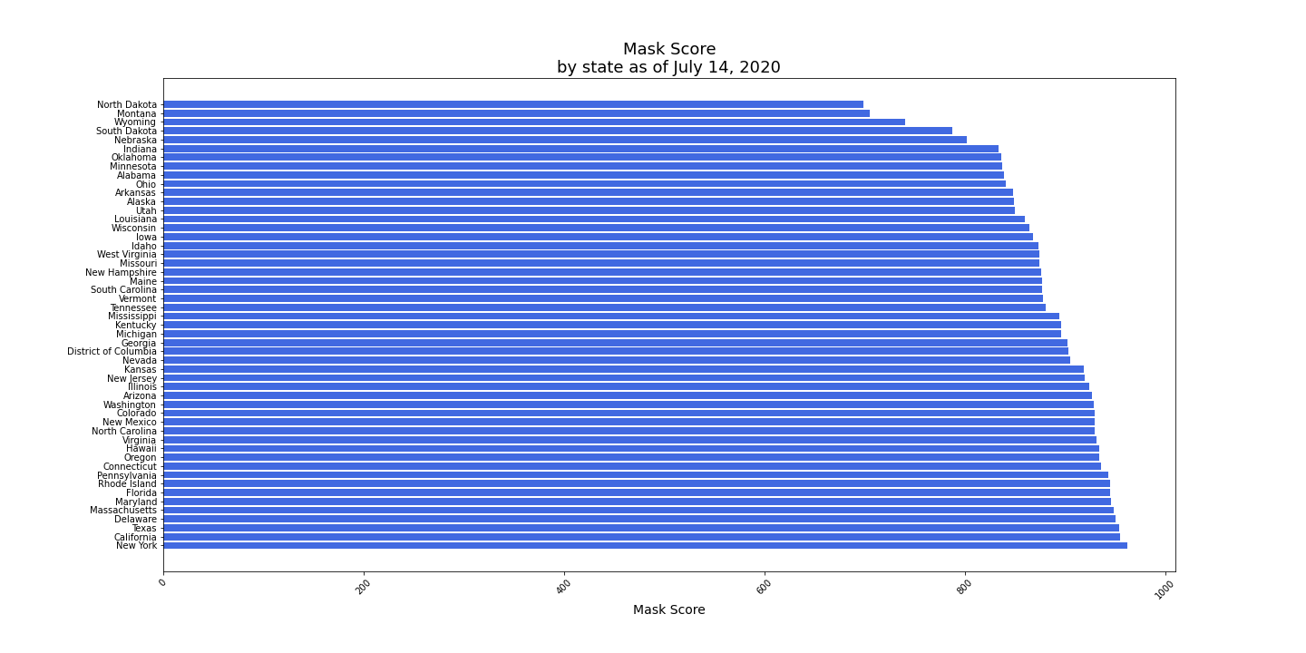
Data analysis
Mask-wearing scores by state
Notes:
Emerson

Slide 12
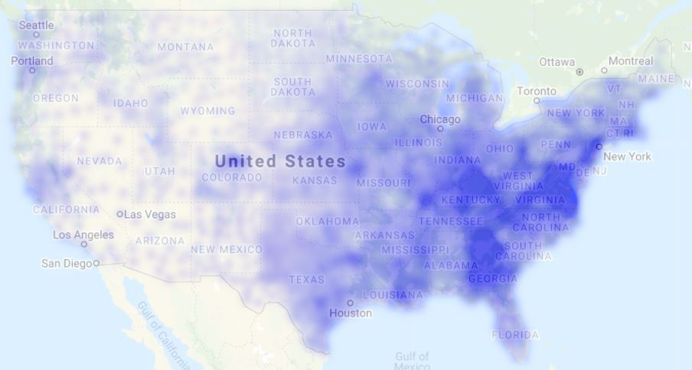
Data analysis
Mask-wearing scores (by County)
Notes:
Emerson
Merge heatmapData and merged_df

Slide 13
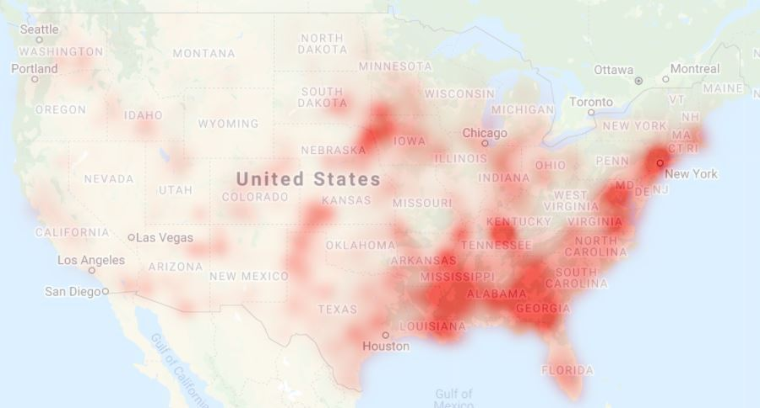
Data analysis
COVID cases per 100,000 pop. (by County)
Notes:
Emerson
Create heatmap for CaseRate

Slide 14
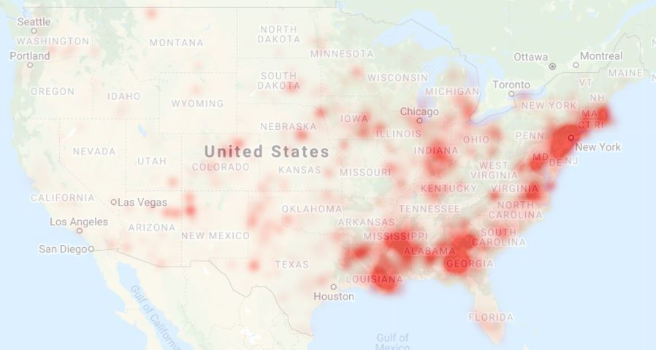
Data analysis
COVID deaths per 100,000 pop. (by County)
Notes:
Emerson
Create heatmap for DeathRate

Slide 15
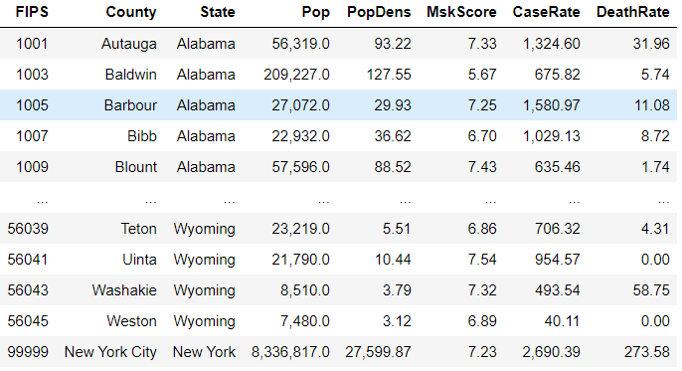
Data analysis
Role of FIPS* and the GBDf**
* Federal Information Processing System
** Great Big Dataframe
Notes:
Paul

Slide 16
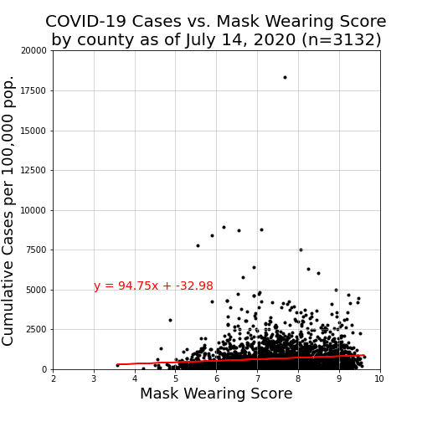
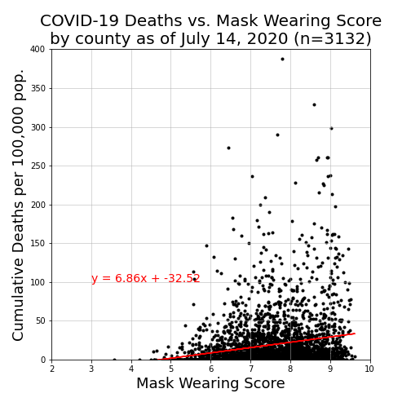
Data analysis
Mask-wearing score vs COVID cases and mask-wearing score vs COVID deaths
Notes:
Paul

Slide 17
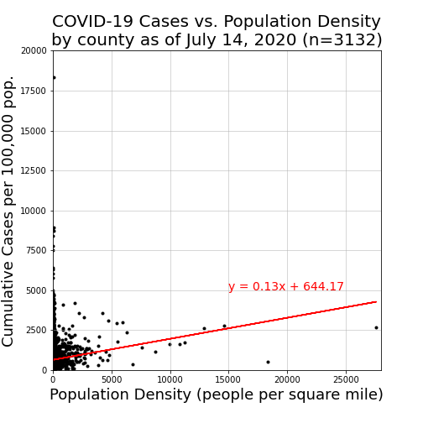
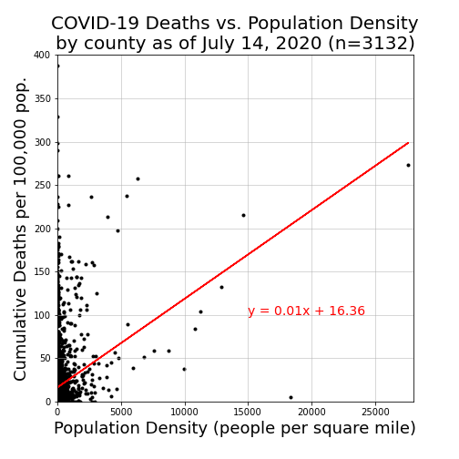
Data analysis
Population density vs COVID cases and population density vs COVID deaths
Notes:
Paul

Slide 18
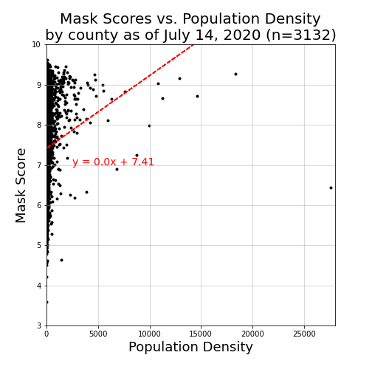
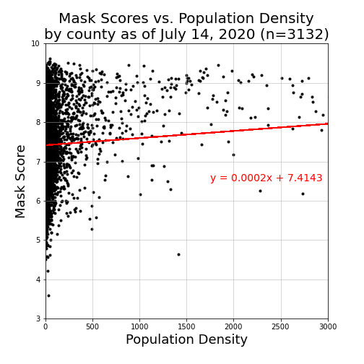
Data analysis
Mask-wearing scores vs population density: full view (left) and “zoomed in” (right)
Notes:
Paul

Slide 19
Data analysis
How strong were the correlations?
 | COVID cases | COVID deaths
Mask-wearing score | 0.1137 | 0.2065
Population density | 0.1420 | 0.2766
 | r-values
Notes:
Paul

Slide 20
Discussion
Discuss our findings.
The NYT survey asked “How often do you wear a mask in public when you expect to be within six feet of another person?”
Did we find what we expected to find? No! If not, why not? -Possible self-reporting bias in the survey data. -Interpretation of “Never”, “Rarely”, “Sometimes”, “Frequently” and “Always”. -We thought we would see increased mask-wearing accompany decreased COVID case rates.
Notes:
Emerson

Slide 21
Discussion
What inferences or general conclusions can you draw from your analysis?
-We actually saw the opposite (increased mask-wearing accompanies increased COVID case rates per 100,000 pop.), but weakly so: an r-value of only 0.1137.
-The strongest correlation we found, between population density and COVID death rates per 100,000 pop., was still rather weak: an r-value of 0.2766.
Notes:
Emerson

Slide 22
Post mortem
Difficulties that arose There’s a great deal of editorial control in some minor-seeming changes to the values max_intensity and point_radius in Google heatmap layers. How we dealt with them We tinkered and compared and discussed.
Notes:
Emerson

Slide 23
Post mortem
Additional questions that came up, but which you didn't have time to answer What would you research next, if you had two more weeks?
-We remain interested to investigate what correlations might exist between median household income by county and the data we have.
-What happened next? It’s been longer now since the mask-wearing survey that it had been from the beginning of the pandemic until the survey. Did counties with low mask-wearing scores in July 2020 go on to have subsequently higher COVID case and death rates?
-What additional statistical analysis could be done on the data we have?
-What would an animated heat map of cases and deaths by county per day look like?
Notes:
Emerson

Slide 24
Top 5 & Bottom 5 County data
Mask wearing scores
9.623 9.555 9.540 9.515 9.513 8.370 8.130 4.576 4.570 4.500 4.208 3.583 | Yates Cnty, NY Lake Cnty, CA Hays Cnty, TX El Paso Cnty, TX Wyoming Cnty, NY … Hennepin Cnty, MN ... Ramsey Cnty, MN ... Benson Cnty, ND Humboldt Cnty, IA Towner Cnty, ND Texas Cnty, MO Wright Cnty, MO
COVID cases per 100,000 pop.
0 0 0 0 0 987 1.140 8,426 8,731 8,795 8,951 18,344 | Butte Cnty, ID Keya Paha Cnty, NE Carter Cnty, MT Blaine Cnty, MT Hayes Cnty, NE ... Ramsey Cnty, MN … Hennepin Cnty, MN ... Buena Vista Cnty, IA Dakota Cnty, NE Lee Cnty, AR Lake Cnty, TN Trousdale Cnty, TN
COVID deaths per 100,000 pop.
0 0 0 0 0 44 63 274 290 299 329 388 | Grant Cnty, NE Harlan Cnty, NE Putnam Cnty, MO Greeley Cnty, NE Gosper Cnty, NE ... Ramsey Cnty, MN … Hennepin Cnty, MN ... New York City, NY Early Cnty, GA Terrell Cnty, GA Randolph Cnty, GA Hancock Cnty, GA
Notes:
Emerson

Slide 25
Questions?

Slide 26
Appendix
questions

Slide 27
Data collection
We used this data to answer our questions: 1 County population: How many people live in each county of the U.S.? U.S. Census 2019 pop. est.
2 Land mass: What is the land mass of each county? ArcGIS Hub
3 Population density: What is the population density of each county? population / land mass
Questions and data slide

Slide 28
Data collection
4 Mask-wearing score: How often do people in each county wear masks? The New York Times and Dynata asked 250,000 people between July 2–14, 2020 “How often do you wear a mask in public when you expect to be within six feet of another person?” The data set presents a percentage for each answer - never, rarely, sometimes, frequently, or always - for each county. We weighted each of these to derive a single mask-wearing score for each county on a scale of 1-10: rarely * 2.5 + sometimes * 5 + frequently * 7.5 + always * 10
5 COVID case count per county: How many cases of COVID had there been in each county up until the survey was finished (July 14, 2020)? The New York Times
Questions and data slide

Slide 29
Data collection
6 COVID death count per county: How many deaths from COVID had there been in each county until July 14, 2020? The New York Times
7 COVID case rate per county: How many COVID cases per 100,000 pop, had there been in each county until July 14, 2020? case count * 100,000 / population
8 COVID death rate per county: How many COVID deaths per 100,000 pop, had there been in each county until July 14, 2020? death count * 100,000 / population
9 Lat/long: What is the latitude and longitude of of each county’s geographical center? B.T. Skinner on GitHub
Questions and data slide

